Slide 1

Standardization of Chilean jack mackerel CPUE fishery in central-southern Chile using Hierarchical Bayesian Models (INLA)
Sebastián I. Vásquez^{1,2} & Aquiles Sepúlveda¹
¹ Instituto de Investigación Pesquera, Talcahuano, Chile. E-mail: svasquez@inpesca.cl
² Programa de Doctorado en Oceanografía, Universidad de Concepción, Concepción, Chile
Jack mackerel stock assessment benchmark, May 2026
Instituto de Investigación Pesquera – www.inpesca.cl

Slide 2
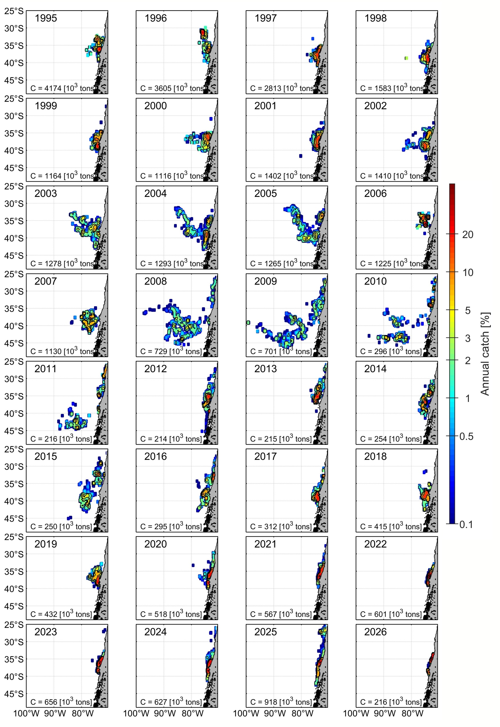
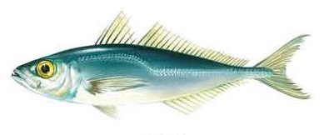
Introduction
CPUE can be influenced by several factors that may invalidate the assumption that the index is proportional to abundance (Hilborn & Walters, 2013).
Most standardization methods (e.g. GLM, GAM) commonly incorporate location as a factor without an additional term for time-space interaction.
This approach assumes the time effect is consistent across spatial strata, with only the average CPUE varying among them (Maunder et al., 2020).
The assumptions of this approach can bias the estimated relative abundance index, especially when the stock's spatial distribution changes over time (Punt et al., 2000).
Spatial and temporal correlations must be considered in modeling, as species at nearby locations share similar habits and environmental conditions (Thorson & Barnett, 2017).
Bayesian hierarchical spatio-temporal models reduce uncertainty in biomass estimates by accounting for spatio-temporal autocorrelation with spatial random effects and autoregressive terms (Cosandey-Godin et al., 2015).
INPESCA www.inpesca.cl

Slide 3
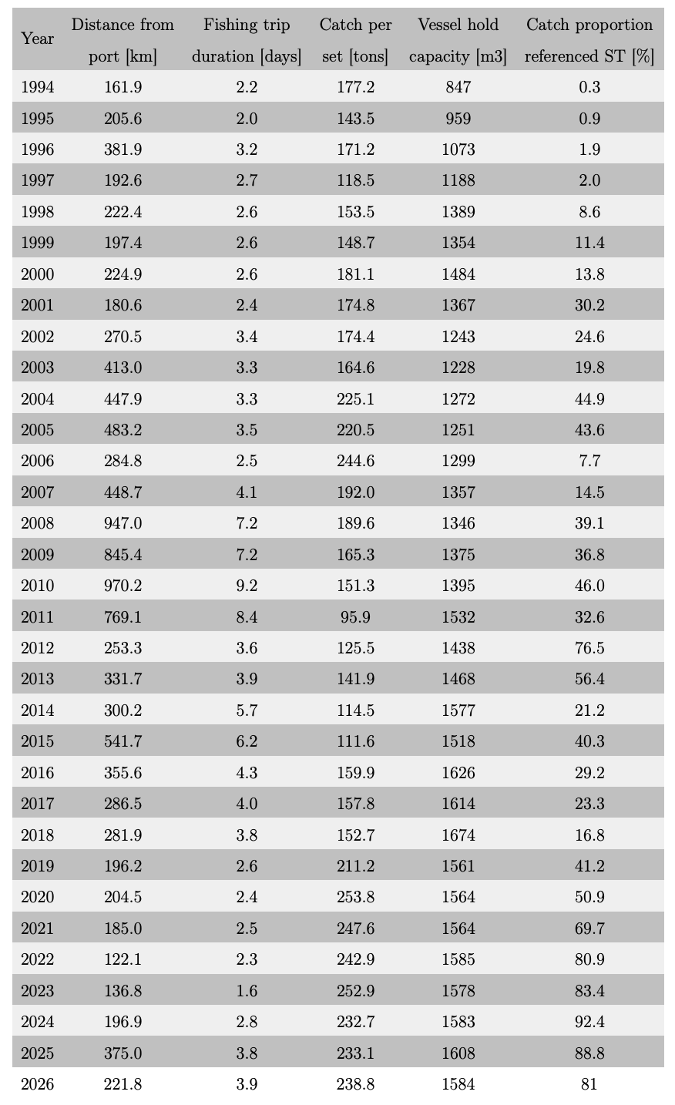
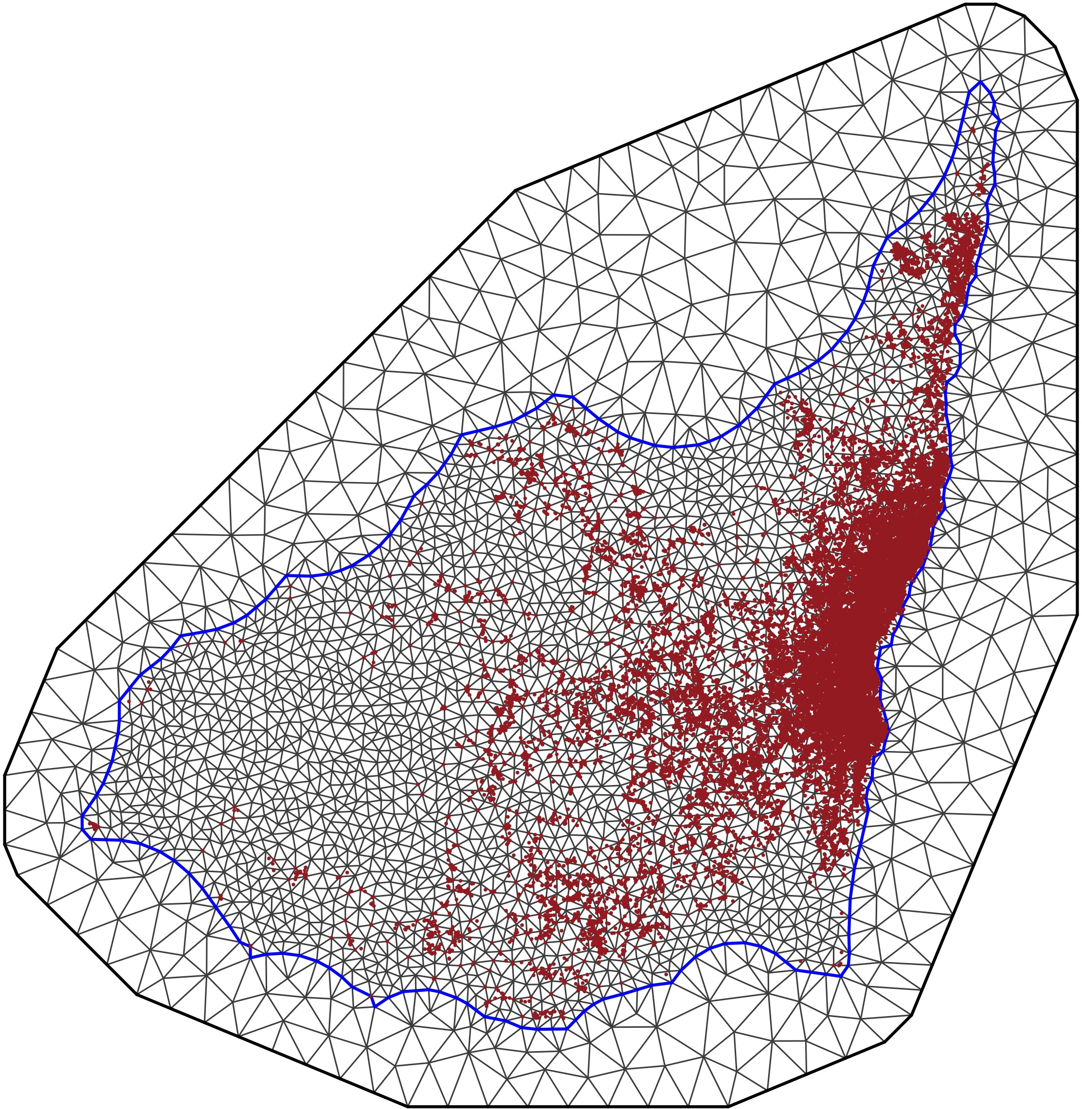
Methods
We used the Integrated Nested Laplace Approach (INLA) by Rue et al. (2009) and the Stochastic Partial Differential Equations (SPDE) method by Lindgren et al. (2011) to model a Gaussian spatio-temporal process with Matérn covariance.
Environmental variables influence habitat preferences, which in turn influence catchability (Arreguín-Sánchez, 1996). We considered two environmental variables: Sea Surface Temperature (SST in °C) and Chlorophyll-a (Chl-a).
The INLA SPDE module allows the construction of a Delaunay triangulation covering the region of interest for the estimation:
41%
3%
2%
INPESCA www.inpesca.cl

Slide 4
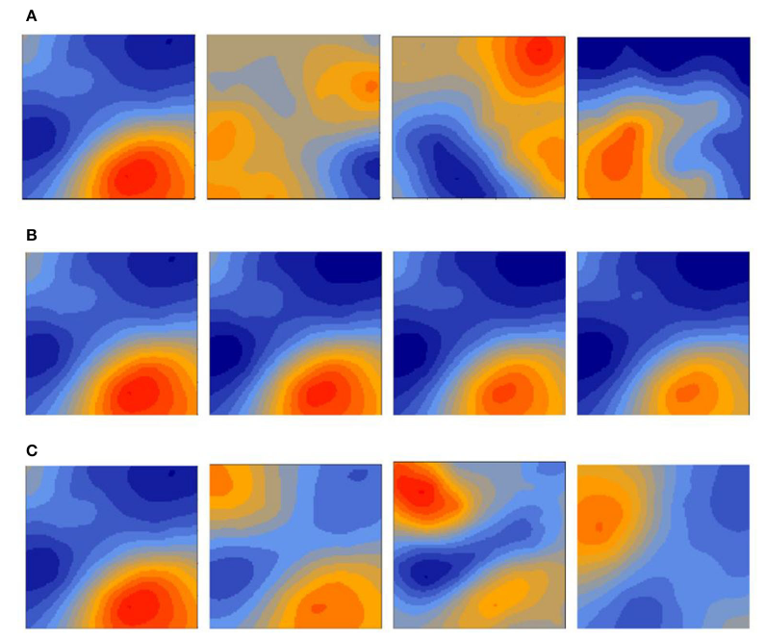
Methods
Model Graphic representation Notation
Opportunistic
Different and uncorrelated realizations of the spatial field every year.
Persistent
A common realization of the spatial field for all years and an additive temporal trend
Progressive
Spatial realizations change over time through a first order autoregressive model; ρ controls the level of correlation between subsequent time events.
Paradinas et al (2017)
where β₀ is the intercept, T_{s,t} is a year effect, Q_{s,t} is a seasonal effect represented by quarter, log(H_{s,t}) is the logarithm of hold capacity of a given vessel operating in location s and year t, log(E_{s,t}) is the logarithm of the days at sea of a given fishing vessel in location s and year t. The term V_{s,t} is a random spatial effect represented by V_{s,t} = w_{s,t}
INPESCA www.inpesca.cl

Slide 5
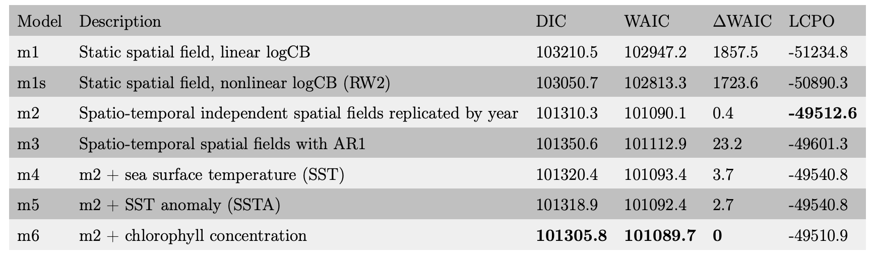
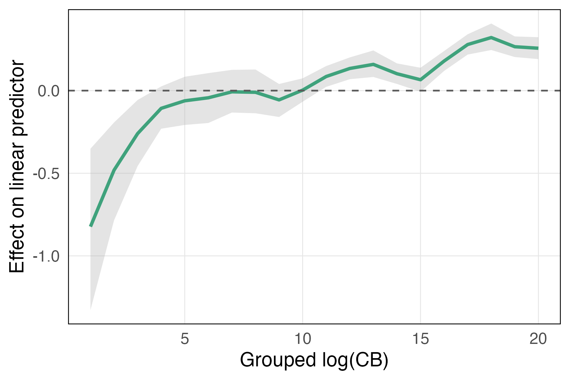
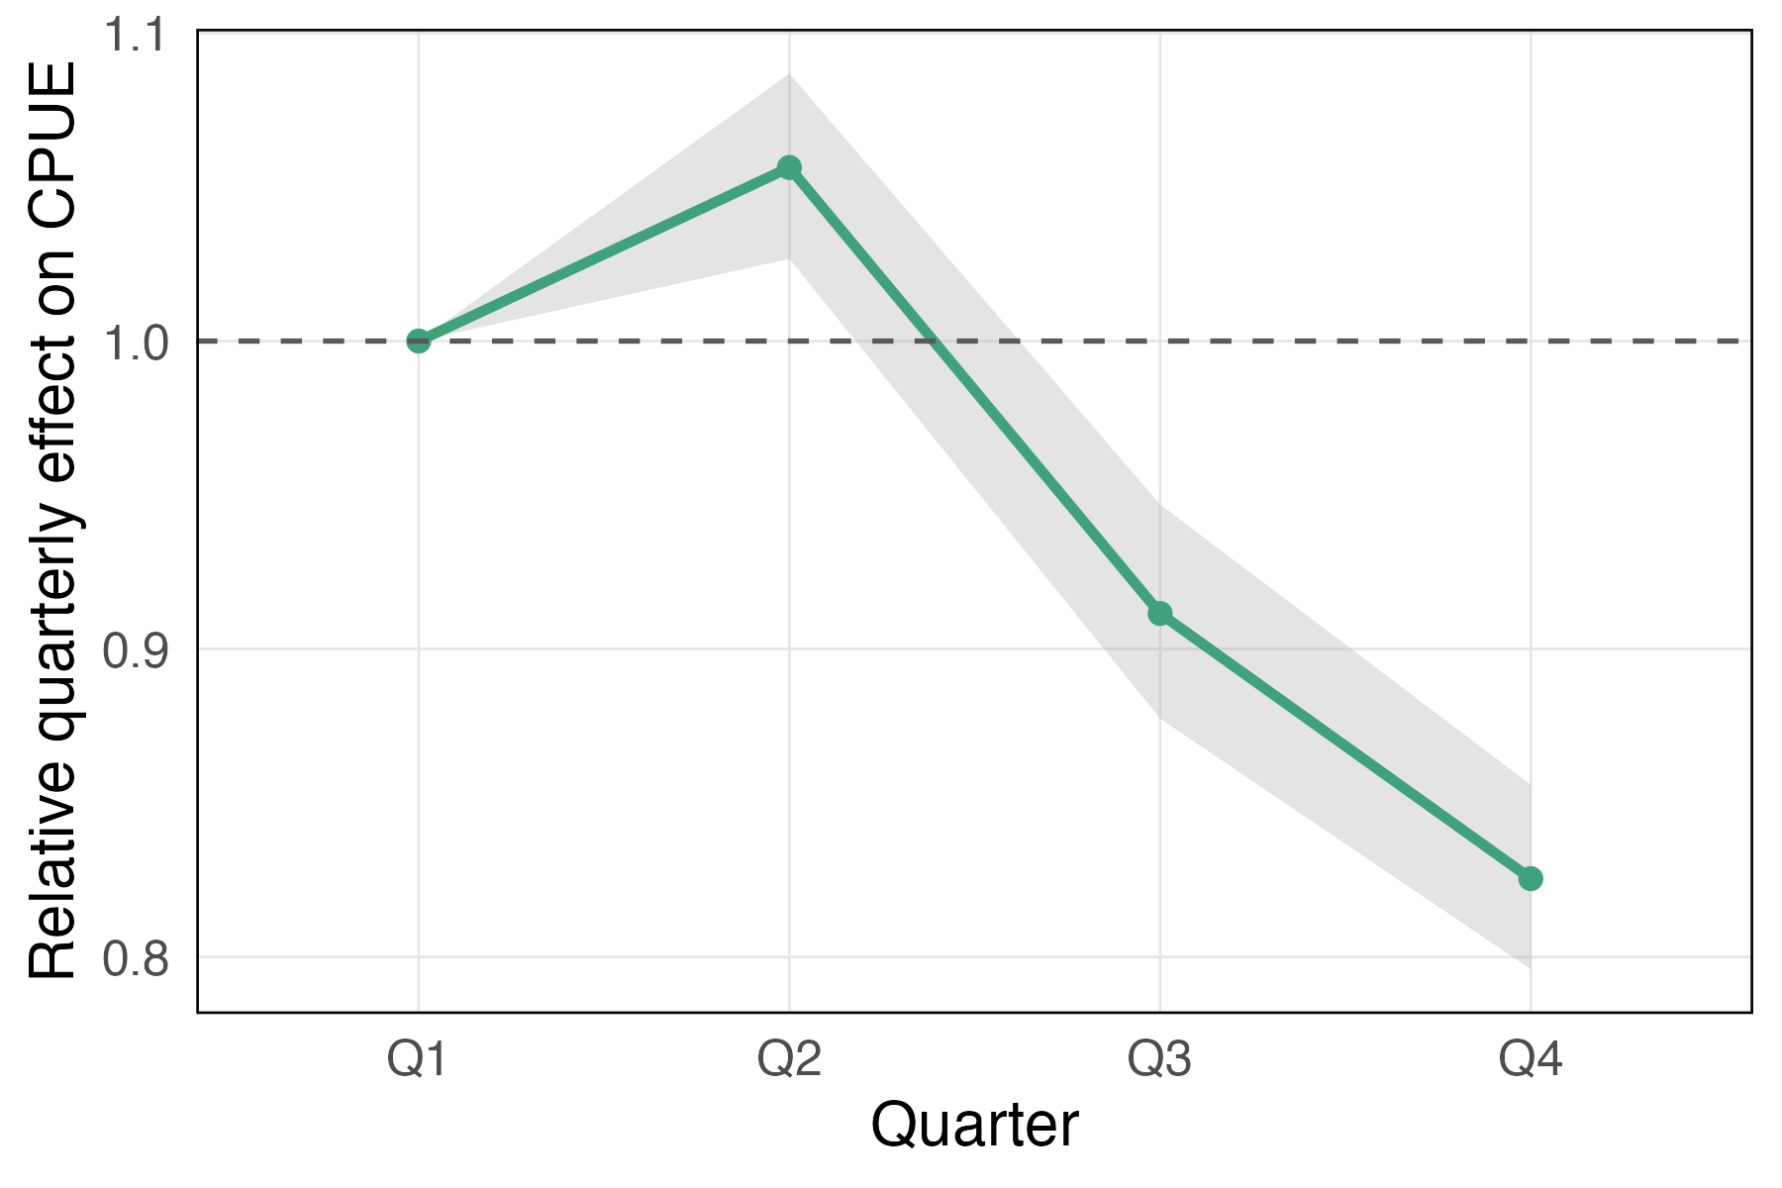
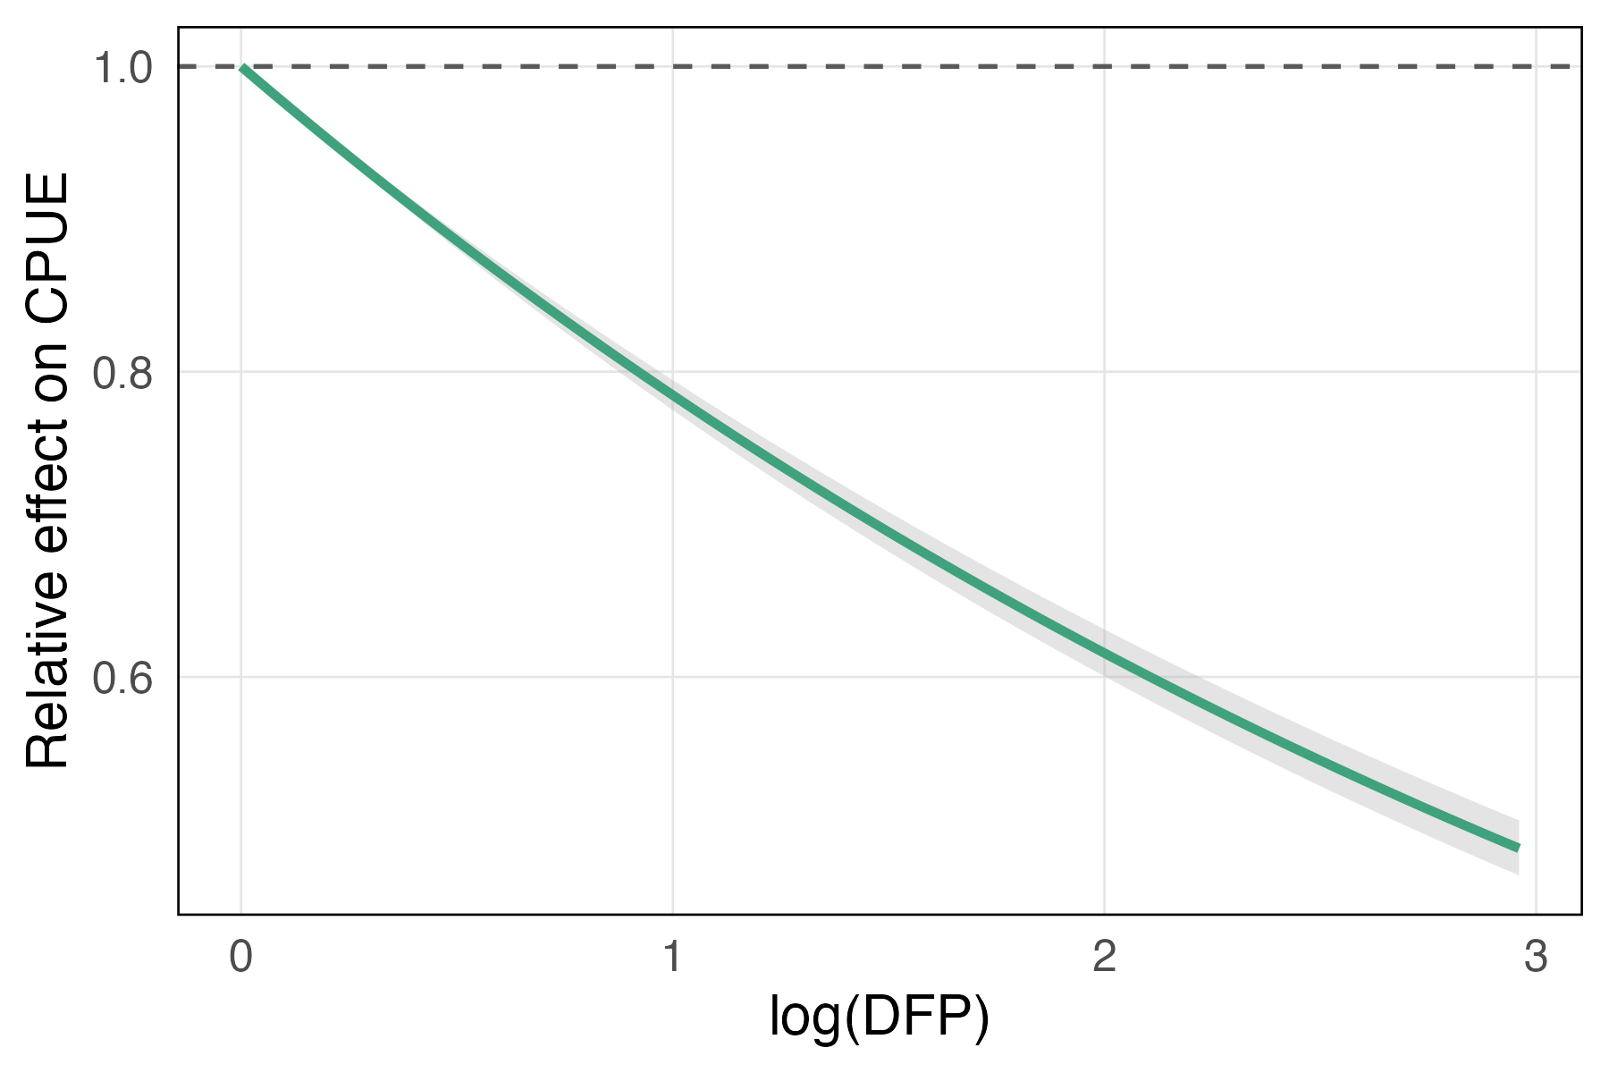
Results
Model selection
Hold capacity effect
Quarter effect
Trip duration effect
INPESCA www.inpesca.cl

Slide 6
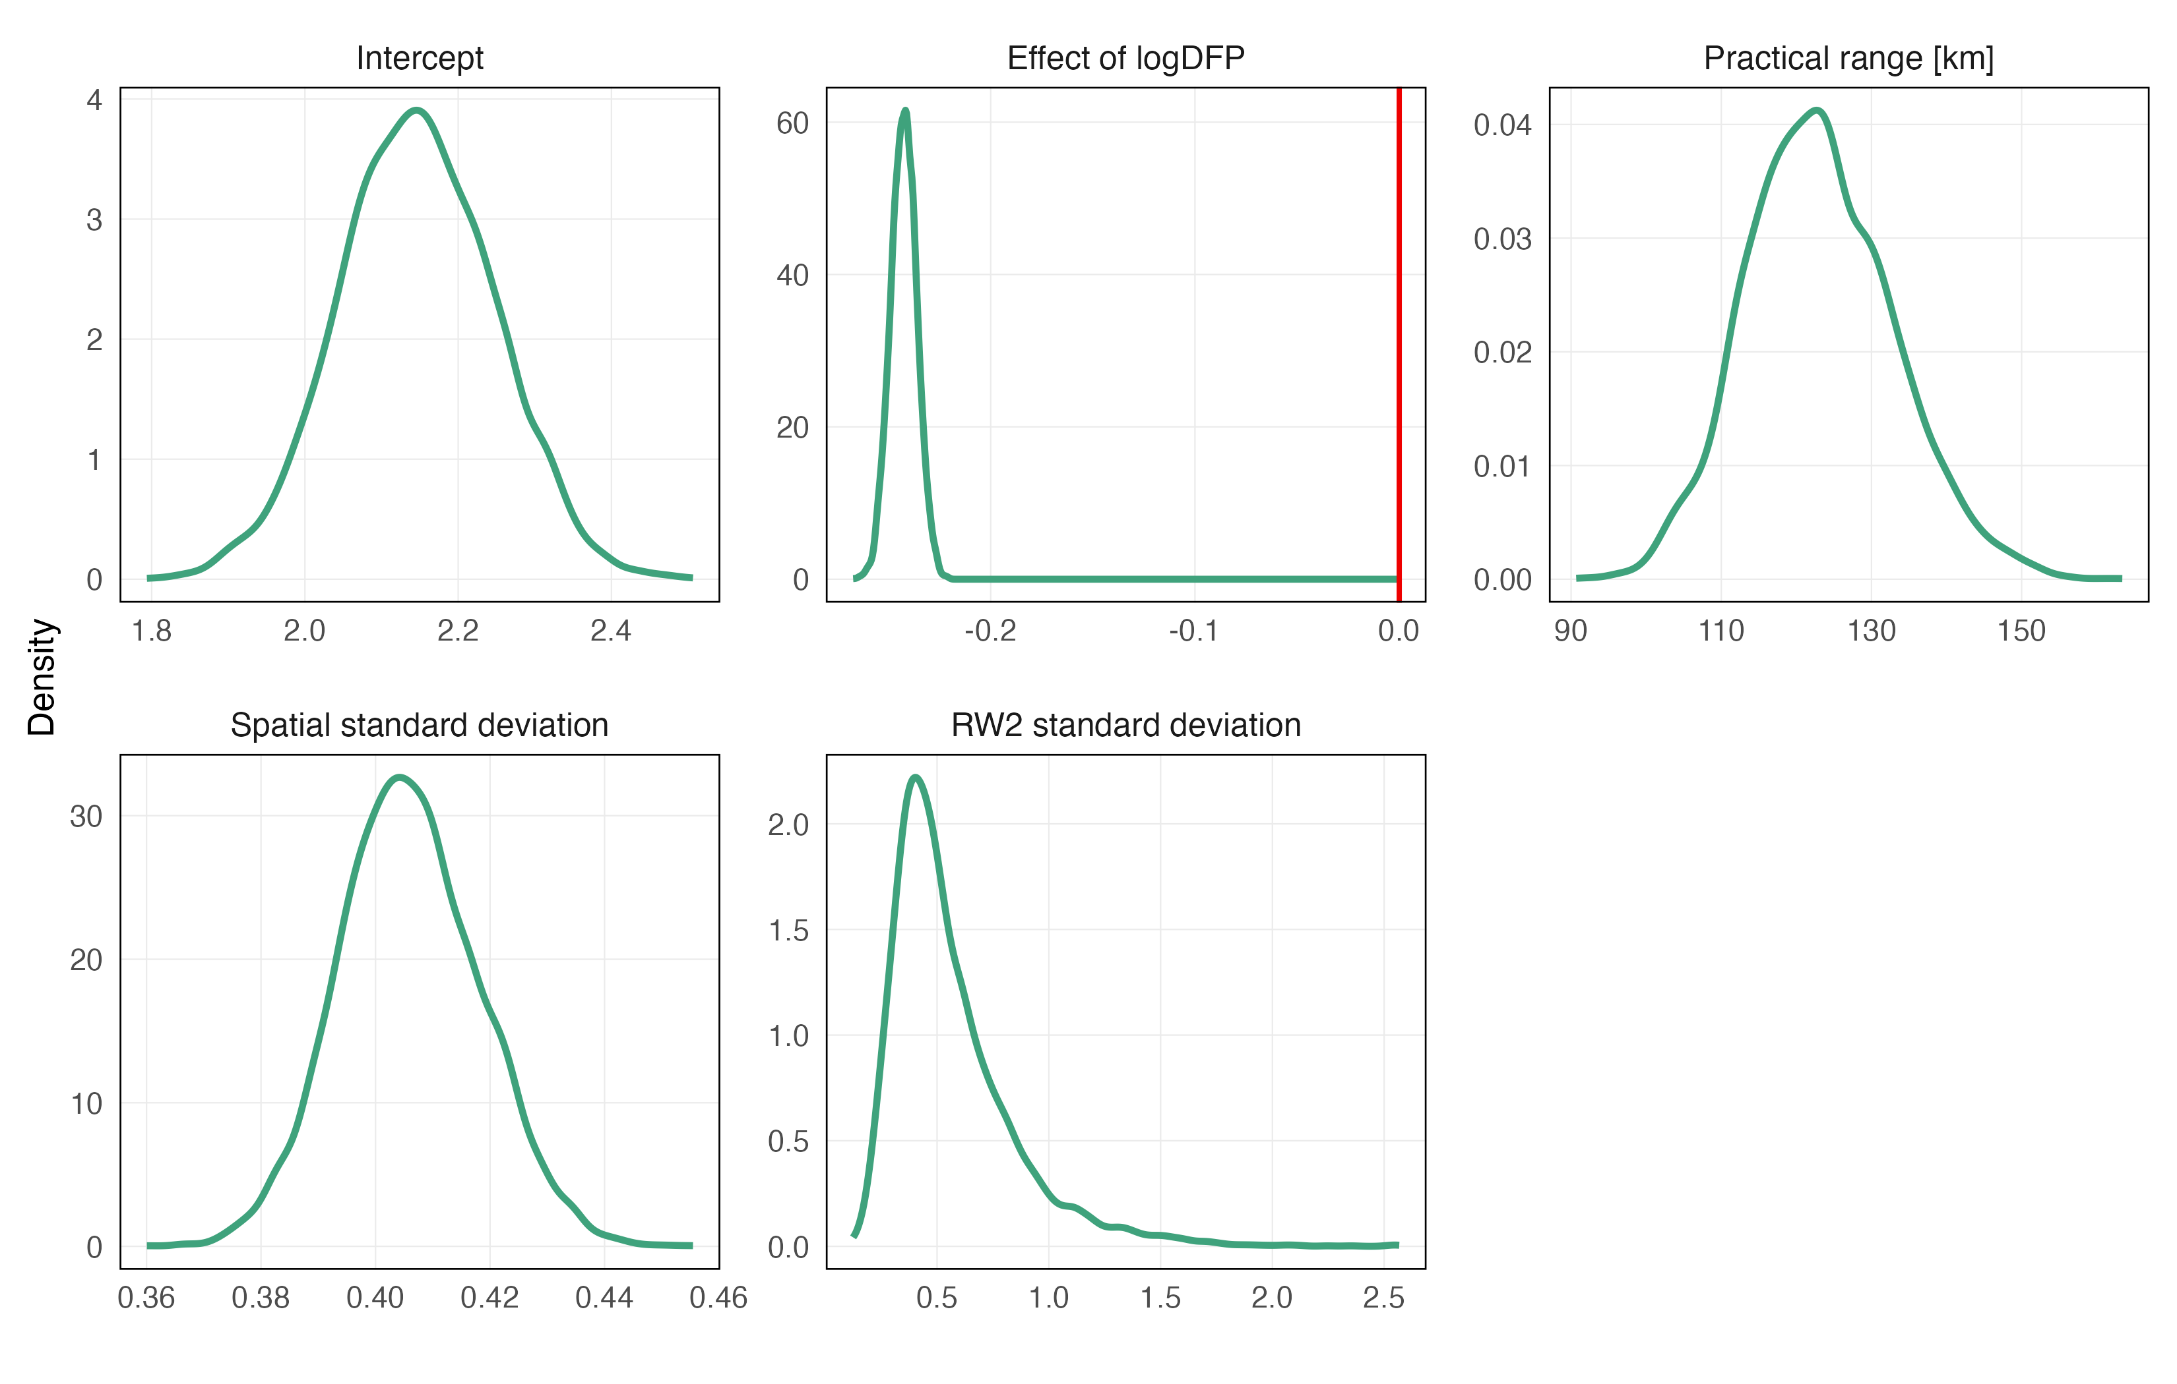
Results
Posterior distributions
Sea Surface Temperature
Environmental conditions fishing season 2023-2024
Sea Surface Chlorophyll-a
INPESCA www.inpesca.cl

Slide 7
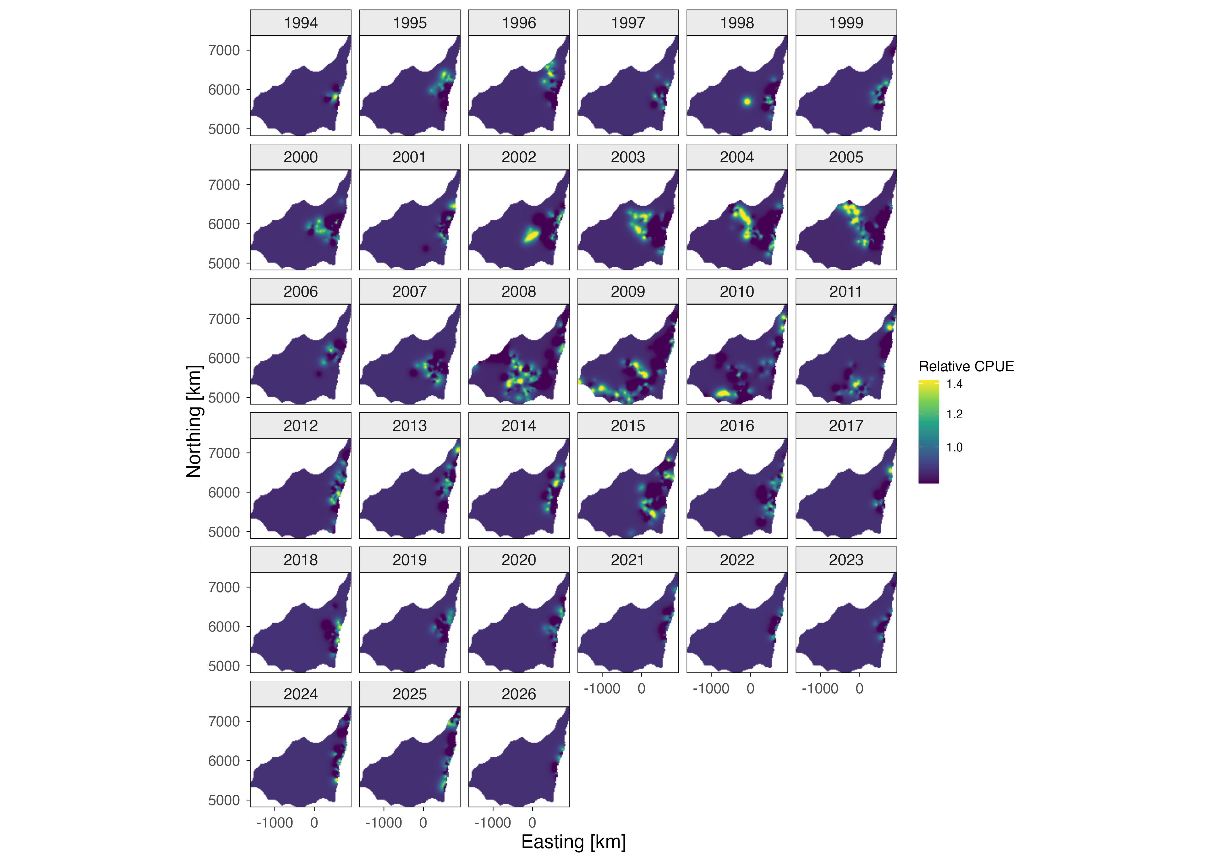
Results
Estimates of the spatio-temporal mean for the CPUE of Chilean jack mackerel
INPESCA www.inpesca.cl

Slide 8
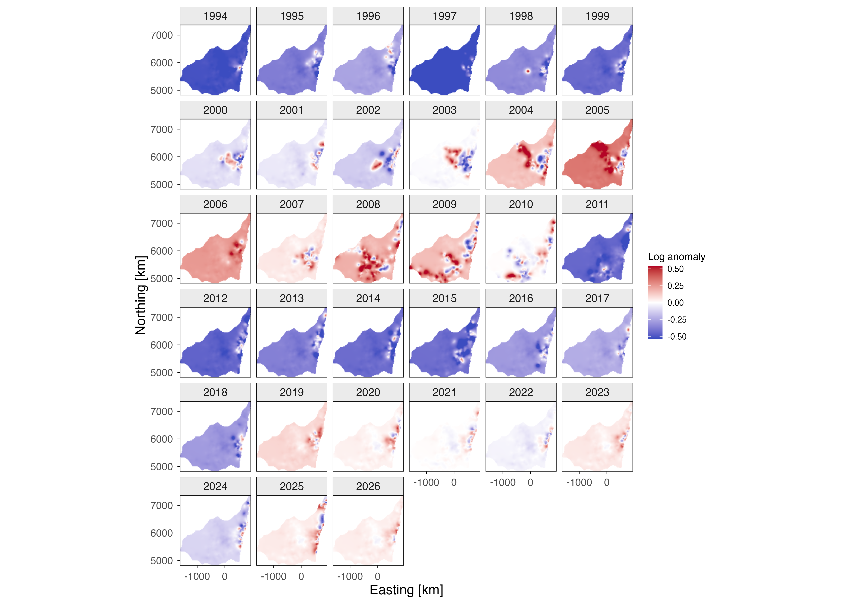
Results
Estimates anomalies of the spatio-temporal mean for the CPUE of Chilean jack mackerel
INPESCA www.inpesca.cl

Slide 9
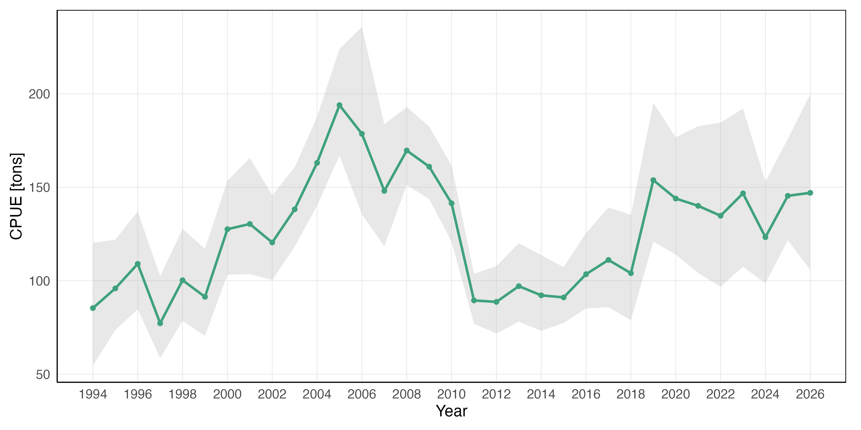
Results
Spatio-temporal predicted biomass (CPUE) index of Chilean jack mackerel (Trachurus murphyi) fishery of central-southern Chile
INPESCA www.inpesca.cl

Slide 10
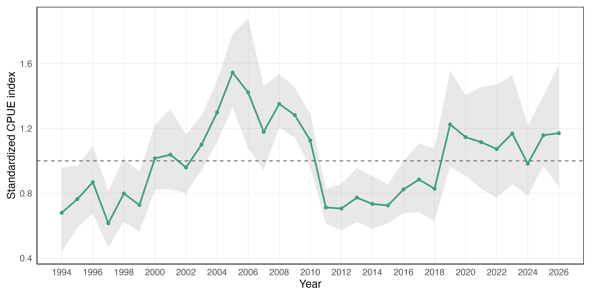
Results
Spatio-temporal predicted biomass (CPUE) index of Chilean jack mackerel (Trachurus murphyi) fishery of central-southern Chile
INPESCA www.inpesca.cl

Slide 11
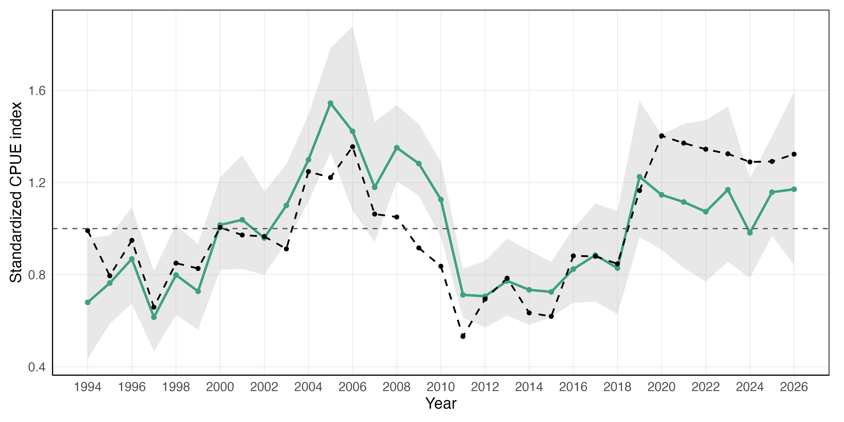
Results
Spatio-temporal predicted biomass (CPUE) index of Chilean jack mackerel (Trachurus murphyi) fishery of central-southern Chile
INPESCA www.inpesca.cl

Slide 12
Concluding remarks
  The INLA–SPDE framework substantially improved model performance, supporting the inclusion of latent spatial structure in CPUE standardization.
  The spatial field revealed persistent hotspots and gradients consistent with known distribution patterns of jack mackerel, confirming that CPUE variability is strongly spatially structured.
  Estimated year effects (relative to the reference level) provided a stable and interpretable abundance signal, effectively filtering out noise associated with uneven sampling effort and shifting fishing grounds.
  Differences between spatial and non-spatial formulations highlight that traditional approaches may confound abundance trends with changes in fleet behavior or spatial targeting.
  Overall, the approach demonstrates that hierarchical Bayesian spatio-temporal models are not only statistically superior but also ecologically more consistent, offering a stronger basis for stock assessment and management advice.
INPESCA www.inpesca.cl

Slide 13
Thank you!
Sebastián I. Vásquez Pastene
Instituto de Investigación Pesquera
e-mail: svasquez@inpesca.cl
INPESCA www.inpesca.cl

